Slide 1
KPMG NLP Skill Assessment

Slide 2
Pretrained Model-
A pre-trained model is a model that was trained on a large benchmark dataset to solve a problem similar to the one that we want to solve. Like:
VGG16 which is Trained on 14 million images belonging to 1000 classes
AlexNet: which is trained over 15 million labeled high-resolution images in over 22,000 categories
BERT model - trained over 800M words of BooksCorpus and 2,500M words from English Wikipedia

Slide 3
Why BERT Model
Introduced by Google, BERT is a PreTrained Model that consists of layers of Transformers and uses Attention Mechanism
BERT is a bidirectional transformer pretrained using a combination of masked language modeling objective and next sentence prediction on a large corpus comprising the Toronto Book Corpus and Wikipedia.
BERT is designed to pre-train deep bidirectional representations from unlabeled text by jointly conditioning on both left and right context in all layers. As a result, the pre-trained BERT model can be fine-tuned with just one additional output layer to create state-of-the-art models for a wide range of tasks, such as question answering and language inference, without substantial task-specific architecture modifications.
BERTBASE (L=12, H=768, A=12, Total Parameters=110M)
Where L=Number of Layers, H = Hidden Size and A = Number of Attention
*Source- https://huggingface.co/transformers/model_doc/bert.html

Slide 4
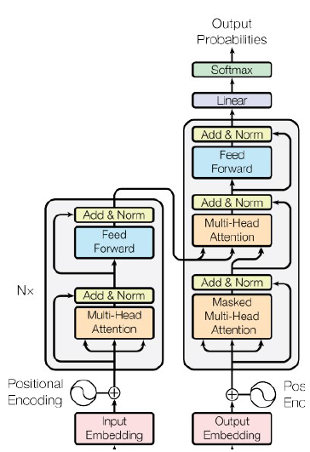
Other Benefit from BERT
BERT model can be fine-tuned with just one additional output layer
Problem of Vanishing gradient can be solved
Supports Parallel computation

Slide 5
DataSet
MIT Movie Eng dataset
url_train='https://groups.csail.mit.edu/sls/downloads/movie/engtrain.bio’
url_test='https://groups.csail.mit.edu/sls/downloads/movie/engtest.bio‘MIT Movie Eng dataset
MIT Movie trivial10k13 dataset
url_train='https://groups.csail.mit.edu/sls/downloads/movie/trivial10k13train.bio’
url_test='https://groups.csail.mit.edu/sls/downloads/movie/trivial10k13test.bio‘MIT Movie Eng dataset
Dataset format: BIO / IOB format (short for inside, outside, beginning) is a common tagging format for tagging tokens in a chunking task in computational linguistics

Slide 6
Approach
BertForTokenClassification model for fitting the data with ADAM optimizer with 5 Epoches
Tokenize Sentences using BertTokenizer
Split data into 90:10 ratio for training and testing
Map the tokens to their entity
Use model created for prediction on test data
Convert python list into Pytorch tensors and combine all tensors using TensorDataset
Pad the sentences to maximum length
Compute F1Score and Accuracy
Create Attention mask for padded tokens

Slide 7
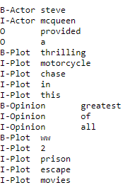
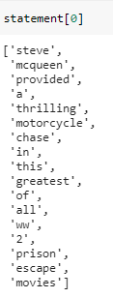
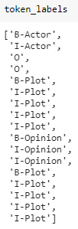
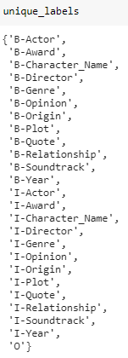
Data Preprocessing
Initial dataset Modified Data Unique Labels
The data is made into statements containing word token in list.
The entity is stored similarly in token_labels
Total unique labels are identified which are stored in Unique_labels(Labels)

Slide 8
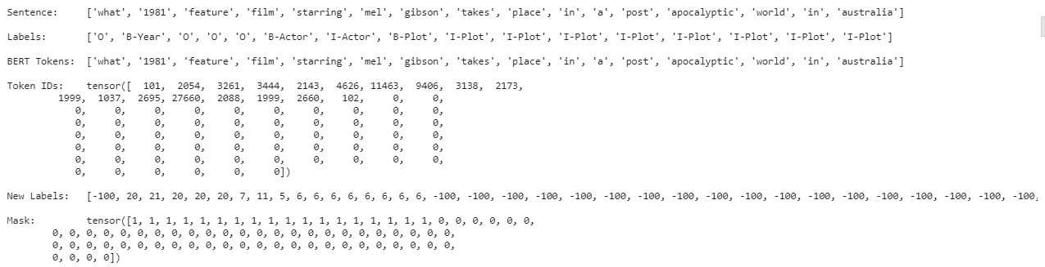
The words in sentences are tokenized using BertTokenizer from “bert-base-uncased” which is Pretrained model on English language using a masked language modeling (MLM)
The input to BERT take fixed size length so the statement are padded to max length sentence.
For Eng data, the maximum length of sentence is 51 word. So, the pad length selected is 55..
For trivial10k13 data, the maximum length of data is 76 words. Similarly, here the pad length is 80.
101 and 102 token are the special tokens which are prepend at the beginning and at the and end of the input text sentence.
Attention mask for padding and truncate the sentences to max length
The list are finally converted into PyTorch tensors using torch.stack

Slide 9

Model Training
The dataset is split into Training and validation set using 90:10 ratio.
Batch size of 32 is used for training the data and total epoch count is 5
Pretained BertForTokenClassification model is used output as label count.
For fine tuning the model, ADAM optimizer is used with learning rate of 5e-5 which is updated linearly to get best rate.

Slide 10
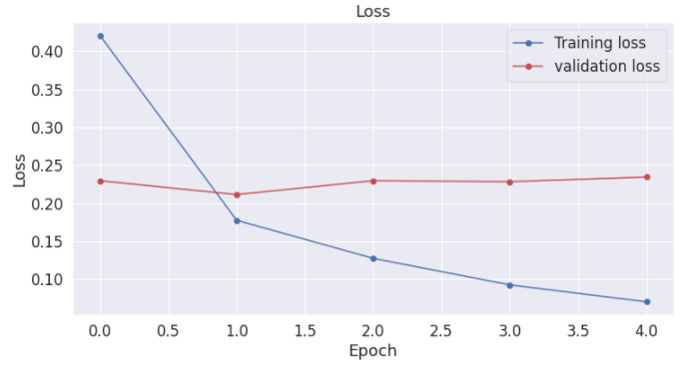
Training and validation Loss

Slide 11


Results
The build model is used to predict entity from test data.
The performance matrix used here is Confusion Matrix. We have computed accuracy, precision, Recall and F1 Score for all the NER category based on which we have used micro F1 score as our evaluation matrix.
For Eng Data:
For trivial10k13 Data

Slide 12
Future Improvements
Instead of BERTBASE model we can use BERTLARGE model, which would have helped in increasing the accuracy of model.
We can look for other Language model as well like XLNet which overcome some drawback of BERT.

